Slide 1

Customer Shopping Behavior Analysis
Uncovering insights from 3,900 purchases to guide strategic business decisions

Slide 2
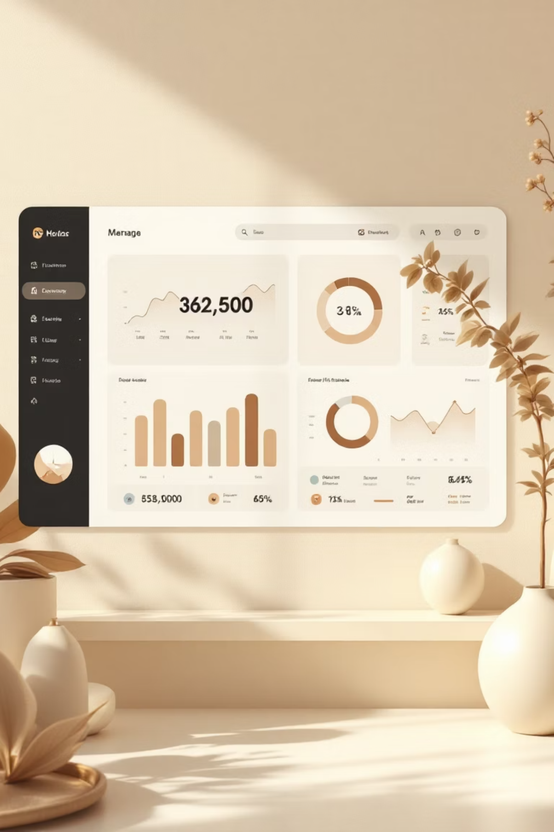
Dataset at a Glance
3,900
18
50
Total Purchases
Data Points
Locations
Transactions analyzed
Features per customer
Geographic coverage
25
Products
Items tracked

Slide 3

Data Preparation Journey
01
Data Loading & Exploration
Imported dataset, checked structure with pandas
02
Missing Data Handling
Imputed 37 missing review ratings using category medians
03
Feature Engineering
Created age groups and purchase frequency columns
04
Database Integration
Connected to PostgreSQL for advanced SQL analysis

Slide 4
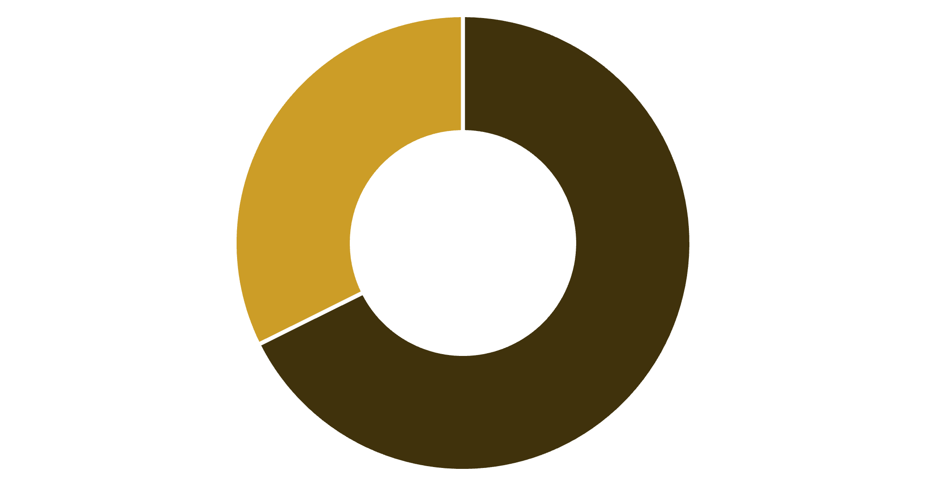
Revenue Insights: Gender & Spending
Male Customers Drive Revenue
Male shoppers generate 68% of total revenue
839 high-spending discount users identified
Average purchase: $59.76
Male
Female

Slide 5



Top Performers
Gloves
Sandals
Boots
Highest rated: 3.86 stars
Runner-up: 3.84 stars
Strong performer: 3.82 stars
Products with highest average review ratings across all categories

Slide 6


Shipping & Subscription Analysis
Express Shipping
Standard Shipping
Average spend: $60.48
Average spend: $58.46
Premium service drives higher purchases
Most popular option
27%
73%
Subscribers
Non-Subscribers
1,053 customers with subscriptions
2,847 customers without subscriptions

Slide 7



Customer Segmentation
New
1
83 customers
Returning
2
701 customers
Loyal
3
3,116 customers
80% of customer base classified as loyal, showing strong retention

Slide 8

Category Performance
Top Products by Category
Discount-Dependent Items
Accessories: Jewelry leads with 171 orders
Hat: 50% discount rate
Sneakers: 49.66%
Clothing: Blouse & Pants tie at 171 orders
Coat: 49.07%
Sweater: 48.17%
Footwear: Sandals dominate with 160 orders
Outerwear: Jacket tops at 163 orders

Slide 9
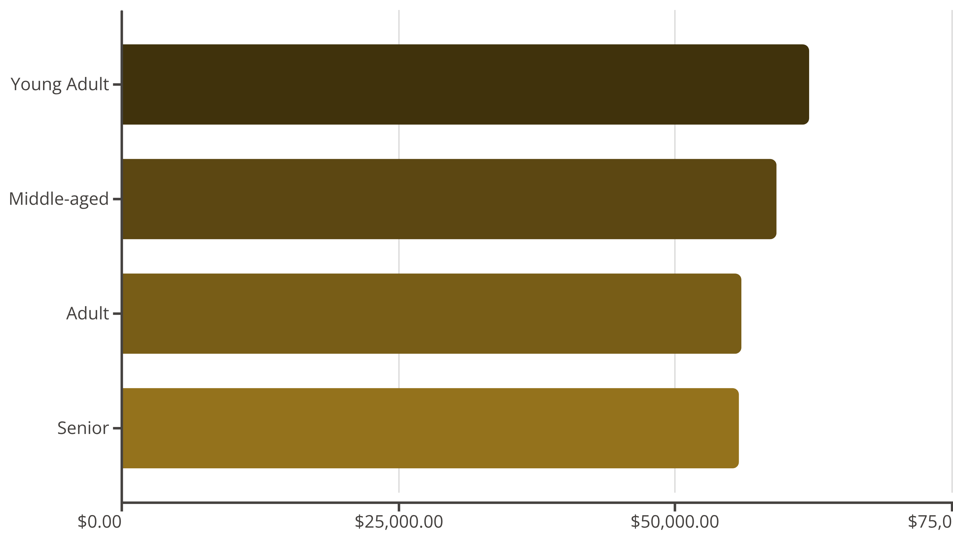
Revenue by Age Group
Young adults generate highest revenue, followed closely by middle-aged customers

Slide 10


Strategic Recommendations
Boost Subscriptions
Promote exclusive benefits to convert 73% non-subscribers
Loyalty Programs
Reward repeat buyers to strengthen loyal segment
Review Discounts
Balance sales boosts with margin control strategy
Targeted Marketing
Focus on high-revenue age groups and express shipping users

